Slide 1


SRI RAMAKRISHNA ENGINEERING COLLEGE
[Educational Service : SNR Sons Charitable Trust]
[Autonomous Institution, Accredited by NAAC with ‘A’ Grade]
[Approved by AICTE and Permanently Affiliated to Anna University, Chennai]
[ISO 9001-2015 Certified and all eligible programmes Accredited by NBA]
VATTAMALAIPALAYAM, N.G.G.O. COLONY POST, COIMBATORE – 641 022.
Department of Electronics and Communication Engineering
16EC258-MINIPROJECT II
No. of Credits : 2

Slide 2
SRI RAMAKRISHNA ENGINEERING COLLEGE
Class / Section / Semester | : | III ECE / C VI
Batch | : | 10
Project Review | : | IV
Title of the project | : | Predictive Analysis to Diagnose Machine Failure in Industries
Date | : | 08.05.2021
Project Guide | : | Mr.J.Judeson Antony Kovilpillai,M.E.,(Asst.Prof)/ECE
Team Members | : | Sathyendraa V.M (1802206) Shri Hari K.B (1802214) Sunil.S (1802230)

Slide 3
OVERVIEW
S.NO | CONTENTS | SLIDE NO.
1 | CHALLENGE STATEMENT | 4
2 | LITERATURE SURVEY | 5,6
3 | EXISTING METHOD | 7
4 | PROPOSED METHOD | 8
5 | BLOCK/SCHEMATIC DIAGRAM | 9
6 | FLOWCHART | 10
7 | IMPLEMENTED ALGORITHM | 11
7 | HARDWARE IMPLEMENTATION | 12,13
8 | SOFTWARE IMPLEMENTATION | 14,15
9 | VIDEO | 16
10 | RESULTS | 17
11 | CONCLUSION | 18
12 | FUTURE WORK | 19
13 | REFERENCES | 20,21

Slide 4
CHALLENGE STATEMENT
Industries use different types of machines to carrry out their daily work. Monitoring these machines manually requires lot of human effort and is time consuming.
Because of various reasons like these the machines are not monitored regularly and also repair and replacement of the machines become costly and hectic after the complete failure of it.
So machine failures can result in adverse effects and it is necessary that good monitoring systems are to be implemented in these industries.
Also predicting the failure of these machines with high accuracy is essential to prevent the failures which will save us cost,time and work.

Slide 5
LITERATURE SURVEY /
BACKGROUND STUDY
PAPER | APPROACH | REMARKS
A Reconfigurable Smart Sensor Interface for Industrial WSN in IoT Environment | Designed based on IEEE1451 protocol by combining with CPLD and the application of wireless communication. | The IEEE1451 protocol can be improved and the function of spreadsheet should be expanded for development in the area of WSN in IoT environment.
Novel Industrial Wireless Sensor Networks for Machine Condition Monitoring and Fault Diagnosis | A novel IWSN with on sensor feature extraction and fault diagnosis and Dempster–Shafer classifier fusion | The feasibility and effectiveness of the proposed system has been demonstrated by a set of laboratory experiments on a single phase induction motor only.
Condition Monitoring Techniques for Electrical Equipment | Technique of monitoring the operating characteristics of machine can be used to predict the need for maintenance before serious deterioration or breakdown occurs. | These do not satisfy specific and essential problems such as partial discharge, hotspot temperature and OLTC. Online diagnosis of all the measured quantities is still under development.

Slide 6
LITERATURE SURVEY /
BACKGROUND STUDY
PAPER | APPROACH | REMARKS
Condition Monitoring and Fault Diagnosis of Electrical Motors | Fault detection and inspection using artificial-intelligence techniques has been included with Noninvasive MCSA technique is used to diagnose these faults | Theoretical analysis and modeling of machine faults are indeed necessary to distinguish the relevant frequency components from the others that may be present due to time harmonics, machine saturation
Monitoring of Electrical Equipment Failure Indicators and Zero-Planned Outages: Past, Present and Future Maintenance Practices. | Maintenance has been driven by a reduction in maintenance budgets, while the need for electrical uptime has become even more critical. There is a dilemma between expectations and the typical maintenance funding resources. | When the equipment is available for maintenance, there is no funding to perform the maintenance, and when the funding is available, the equipment is not accessible to perform the required maintenance.

Slide 7
EXISTING METHOD
Many industries do not implement an monitoring systems as cost of establishment can be high and even if implemented the methods are very basic.
The implementation of multiple sensors is also required to monitor the industrial machines precisely.
The monitoring of machines depends on limited data and does not include any historical and statistical data of each machines.
Prediction of machine failure is also not that accurate as they are not done using advanced methods .

Slide 8
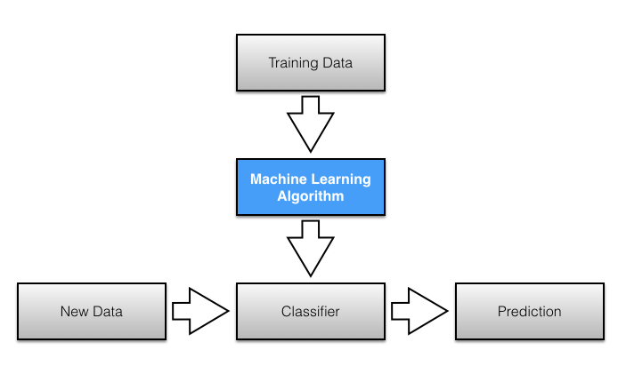
PROPOSED METHOD
The main objective of our project is designing a microcontroller based monitoring and alerting industrial system with the help of multiple sensors.
The data is collected by the microcontroller using multiple sensors and with the help of this data, prediction of failure or problem of the industrial machines is made by an already trained machine learning model.

Slide 9
BLOCK / SCHEMATIC DIAGRAM
Temperature and
Humidity Sensor
Raspberry Pi
Pressure Sensor
Display
The trained LR classifier will predict whether the machine will fail or not with the data given by the sensors.
MQ -2 Gas Sensor
22-08-2019
MP-II
9

Slide 10
FLOWCHART
Collect the sensor data from the industry machines and form a clean dataset.
Train the Classifier with the collected data using ML algorithm.
Predict with the trained classifier whether the machine will fail or not with the data by our sensor.

Slide 11
IMPLEMENTED ALGORITHM
The dataset to train the model is collected and is trained using Logistic Regression.
The algorithm is implemented in anaconda IDE platform using libraries and packages like keras,numpy,sklearn and pandas.
A dataframe of 8703 rows and 3 columns is given to the sigmoid function to train the LR classifier using gradient descent.
The values obtained from the sensors is given to the trained classifier to make predictions whether the machines will fail or not.

Slide 12
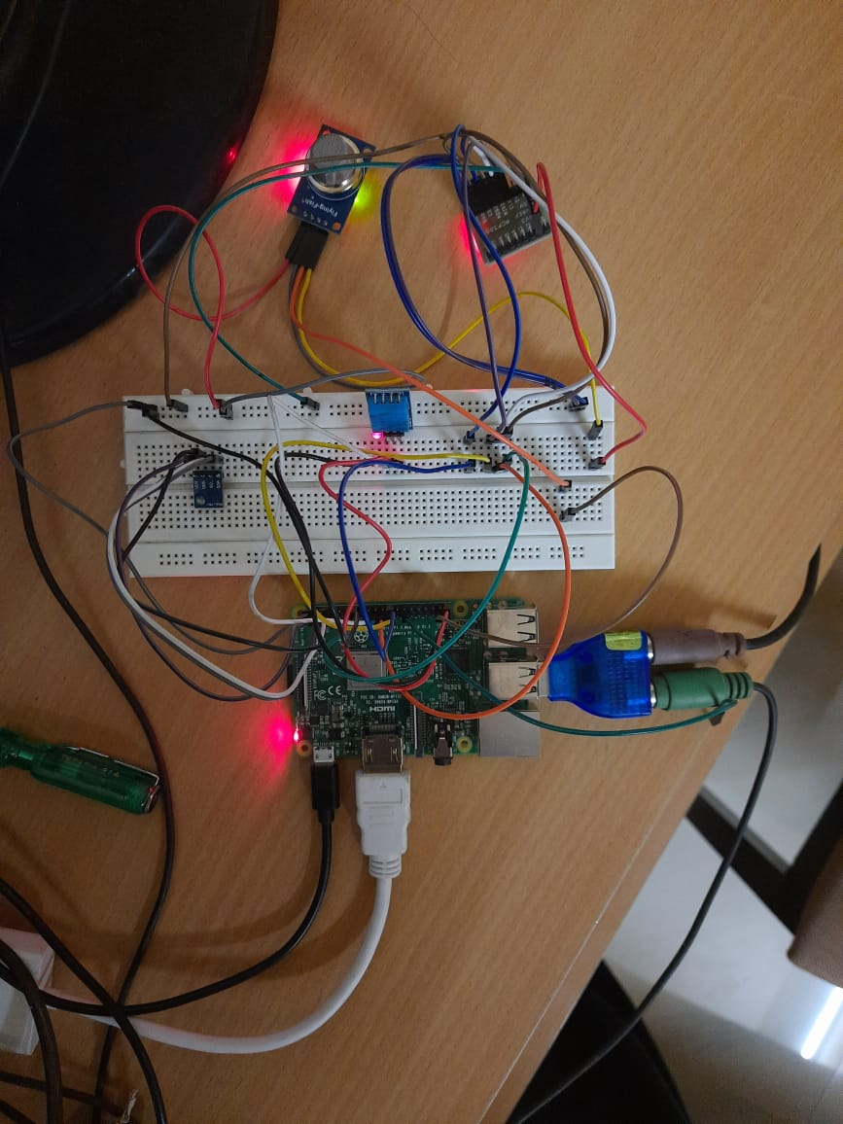
HARDWARE IMPLEMENTATION

Slide 13
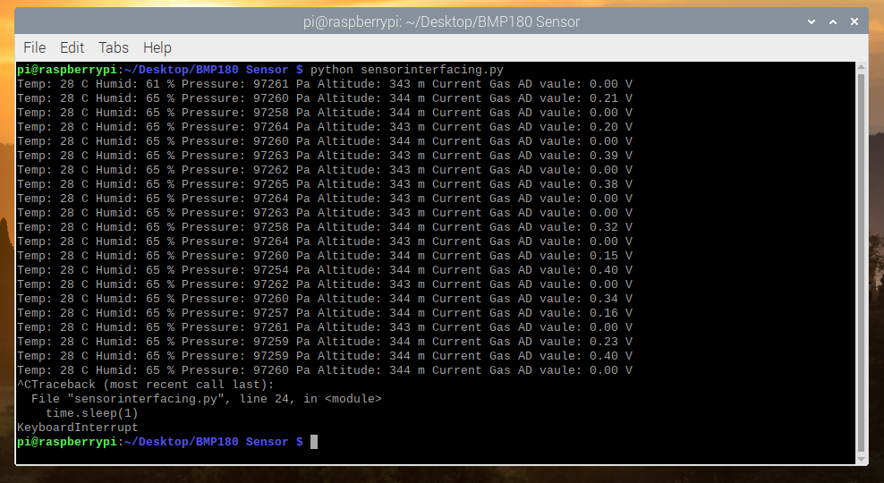
HARDWARE IMPLEMENTATION

Slide 14
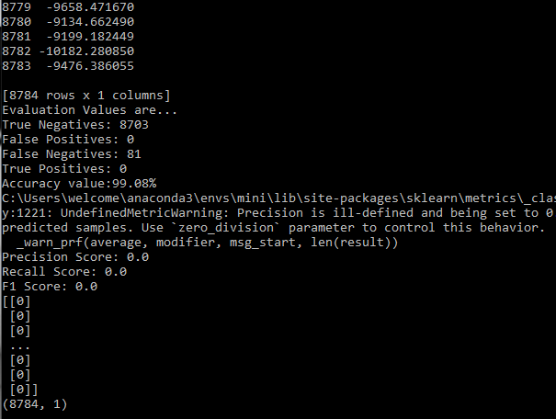
SOFTWARE IMPLEMENTATION
Training Set Accuracy:

Slide 15
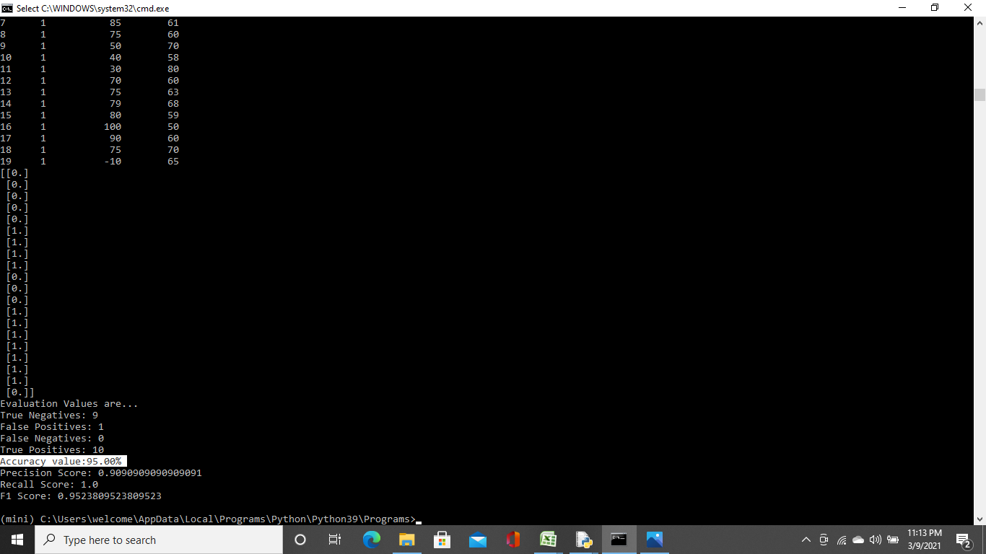
SOFTWARE IMPLEMENTATION
Test Set Accuracy:

Slide 16
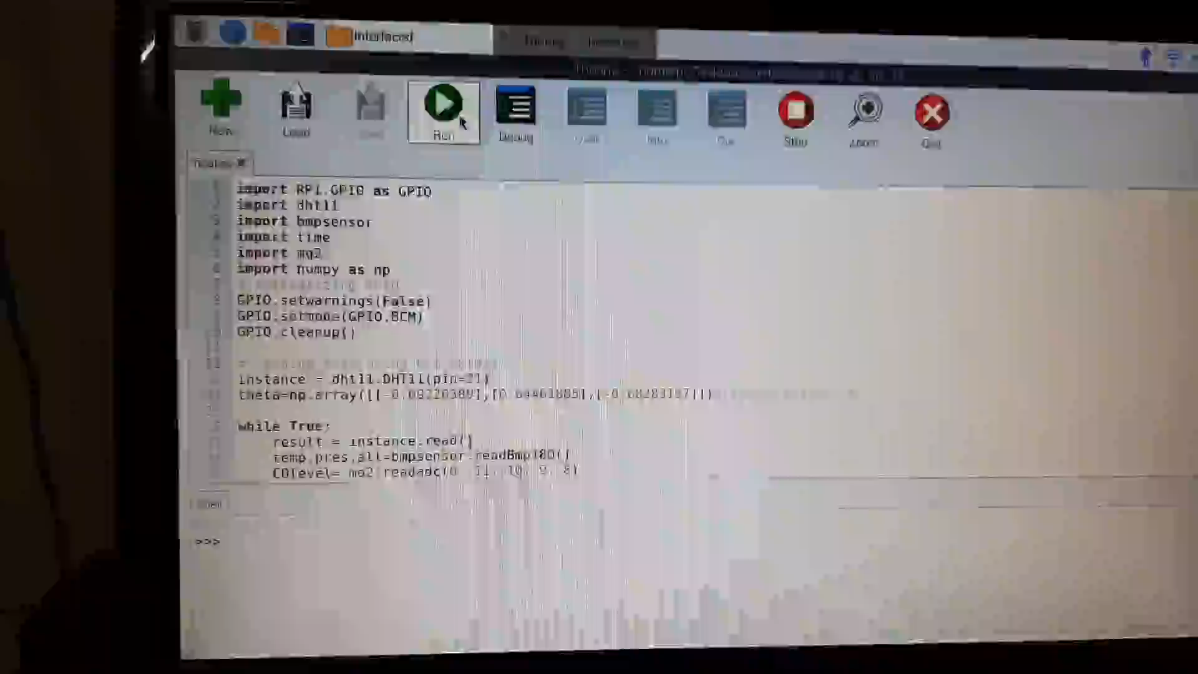
VIDEO

Slide 17
RESULTS
The trained classifier displays the condition of the machine in real time as good or failed.
So the failure of the machines in predicted by the classifier at around temperature above 50 Celsius and humidity below 40.
The accuracy of the system is high with 95% in test set which makes this system highly reliable.

Slide 18
CONCLUSION
Machine Learning has a lot of applications and Predctive analysis is one of the best field in which it can have accurate results making it a very powerful application.
We implemented a small part of this topic and tried to predict the machine failures with the help of sensors and microcontroller which can prevent many undesirable outcomes in industries.

Slide 19
FUTURE WORK
We were able build a system that can predict with 95% accuracy with just two parameters.So increasing the number of parameters can greately improve the model.
Advanced algorithms like Neural networks or SVM can be used to make more accurate and fast predictions.
Microcontroller specifically made to implement this application can improve the processing speed.

Slide 20
REFERENCES
Ethem Alpaydin (2020). Introduction to Machine Learning (Fourth ed.). MIT. pp. xix, 1–3, 13–18. ISBN 978-0262043793.
"The First Wave of Corporate AI Is Doomed to Fail". Harvard Business Review. 2017-04-18. Retrieved 2018-08-20.
Stevenson, Christopher. "Tutorial: Polynomial Regression in Excel". facultystaff.richmond.edu. Retrieved 22 January 2017.
"The Netflix Tech Blog: Netflix Recommendations: Beyond the 5 stars (Part 1)". 2012-04-06. Archived from the original on 31 May 2016. Retrieved 8 August 2015.
"Cyberthreats, Vulnerabilities and Attacks on SCADA Networks" (PDF). Rosa Tang, berkeley.edu. Archived from the original (PDF) on 13 August 2012. Retrieved 1 August 2012.
Le Roux, Nicolas; Bengio, Yoshua; Fitzgibbon, Andrew (2012). "Improving First and Second-Order Methods by Modeling Uncertainty". In Sra, Suvrit; Nowozin, Sebastian; Wright, Stephen J. (eds.). Optimization for Machine Learning. MIT Press. p. 404. ISBN 9780262016469.

Slide 21
REFERENCES
Friedman, Jerome H. (2012). "Data Mining and Statistics: What's the connection?". Computing Science and Statistics. 29 (1): 3–9.
Ian H. Witten and Eibe Frank (2011). Data Mining: Practical machine learning tools and techniques Morgan Kaufmann, 664pp., ISBN 978-0-12-374856-0.
Boys, Walt (18 August 2009). "Back to Basics: SCADA". Automation TV: Control Global - Control Design.
Pedro Domingos (September 2015), The Master Algorithm, Basic Books, ISBN 978-0-465-06570-7.
Machine learning and pattern recognition "can be viewed as two facets of the same field."[3]:vii

Slide 22
THANK YOU

